Slide 1
Meeting Week 2
Last week overview
  Readings papers for model augmentation
    Mainly about orthonormality
This meeting:
  Are there any concepts from Kessels that are useful for dual-gantry?
  How can the orthogonality methods be used to overcome mentioned limitations in Kessels?
Notes:
I scanned over Kessels for some potential useful concepts
(Additional paper dual-gantry methods)

Slide 2
Kessels
Inverse Mapping Parameter Updating (IMPU)
  Online phase keeps updating in real time → might cause an issue / conflicting with augmented approach.
    Calculating the subspace to avoid is expensive (uses SVD)
  Offline training – simulation environment
    Generate training dataset by randomizing Telica datasheet parameter ranges? Instead of collecting data first?
    (Pick and place cycle)
Feature Selection for Synchronization for Parallel Axis
  From the model based decoupling: synchronization error
    Kessels' Feature Selection (FS) strategies (Joint Mutual Information (JMI) might be useful) to identify which physical parameter is causing the issue
      JMI might be able to select features correlated with the Y-axis motion profile, which allows to accurately update the cross-arm parameters

Slide 3
Augmentation - Kessels
Augmentation (Correcting Force Equations):
  Problem: The gantry paper ignores "detent forces" (cogging forces from the linear motors) and assumes simple Coulomb/Viscous friction
  Solution: Use Kessels' augmentation strategy to add a Recurrent Neural Network (RNN) term to the force equations (fS​ in Eq. 15 of the gantry paper). This RNN would learn the nonlinear, position-dependent detent forces and cable drag that the analytical model misses.
  (Link to Orthonormality paper Maarten and Roland)
Extension (Adding Missing States):
  Dual-gantry 37.7 Hz: jerk rate → Instead use Kessels’ Subspace Encoder to introduce new states (x_excitation) to the state-space model → allows feedforward to compensate fr base vibrations
    Also allows to capture flexible modes
  (Papers Jan also have a solution for this)
Uncertainty Quantification (UQ) for High-Reliability Control:
  Telica system operates at 7,500 UPH (Units Per Hour)
    Kessels' Probabilistic Bayesian Neural Networks (PBNN) (Chapter 4) can be applied to the parameter updating process.
    Insteadof a single value for the payload mass, the system outpus a probability distribution.
      Benefit: If the gantry performs a move that doesn't excite the system enough to identify friction (high uncertainty), the PBNN will report a wide confidence interval. The control system can then decide not to update the feedforward gains based on this uncertain data, preventing instability

Slide 4
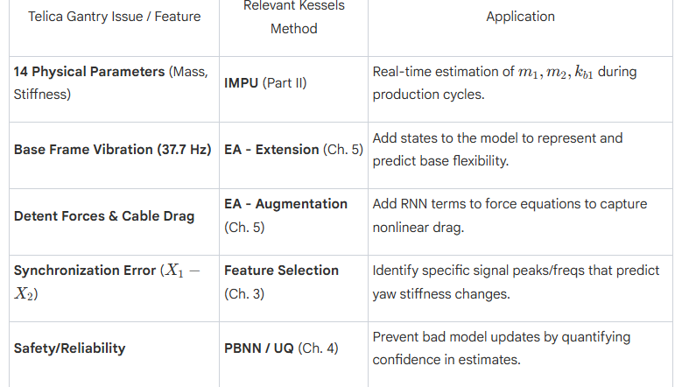

Slide 5
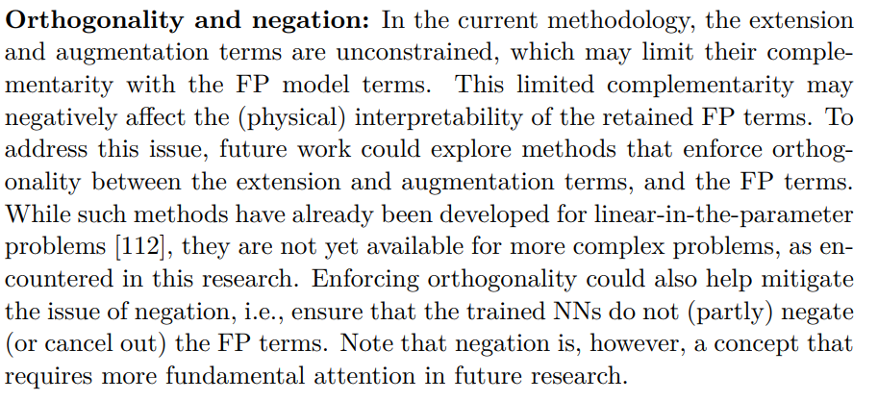
Augmentation - Orthogonality
Kessels mentions limitation
  To prevent the augmentation from learning the same parameters as the FP
    He introduces orthogonality for non-linear systems

Slide 6

Orthogonal Parameterization - Györök method
Györök enforces the neural network cannot learn dynamics already represented by the physics model
Concept: Project the NN output onto the null space of the physics regressor matrix Φ
  Φ is the mathematical representation of the physics based model output (subspace)

Slide 7
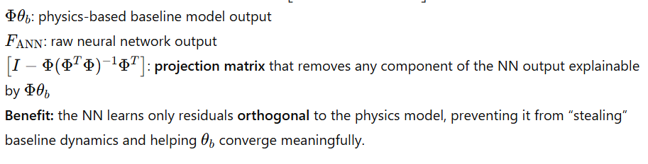

Slide 8

Orthogonal Regularization (Kon method)
Less computation expensive; add a penalty term to the training cost function
Π_x,u, f_ANN: projection of the neural network output onto the physics model’s subspace.
  Project is penalized in case the NN tries to mimic the physics model → cost increases.
Györök extends Kon’s method for nonlinear models:
  Uses the Jacobian of the physics model to define the subspace locally
    Uses taylor expansion on the physics model to linearize it; the Jacobian defines the local subspace

Slide 9
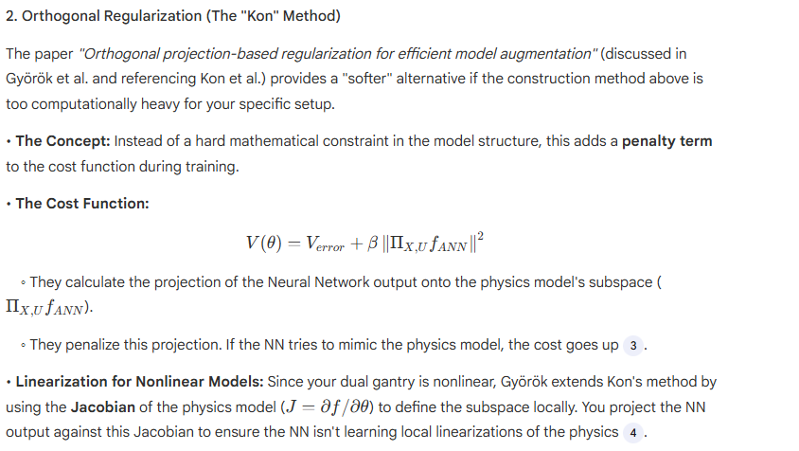

Slide 10
Advanced Synchronization Control of a Dual-Linear-Motor-Driven Gantry With Rotational Dynamics
Detailed Modeling of Bearing Stiffness
  While García-Herreros models the flexible joints simply as lumped springs (kb1​), Li et al. provide a more detailed physical derivation of where this stiffness comes from.
  The Insight: They model the linear guide rails as distributed horizontal springs. They derive an "equivalent rotational stiffness" (Kα​) by integrating the stiffness of the bearing balls over the length of the carriage block
Rotational Friction Modeling
  The García-Herreros paper explicitly ignored the torque associated with friction to simplify their decoupling control. Li et al., however, demonstrate that friction is critical in the rotational dynamics.
  The Insight: They include a term Fri​ (combined viscous and Coulomb friction) directly in the rotational dynamics equation: They show that differences in friction between rail 1 and rail 2 (B1​=B2​) contribute to the synchronization error.
    Relevance: If your "Physics-Informed" neural network is trying to learn missing dynamics, explicitly including this friction asymmetry in your baseline physics model (which García-Herreros omitted) will reduce the burden on the neural network, preventing it from having to "learn" basic friction physics that could have been modeled analytically.
Internal Force Regulation
introducing Adaptive Robust Control (ARC), which actively learns and compensates for the errors that the decoupling method neglects.

Slide 11
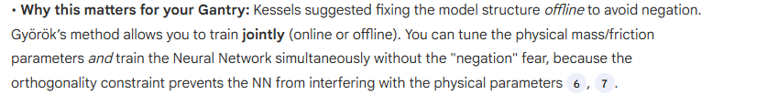
How can Adaptive Robust Control enhance gantry synchronization?
Online Parameter Adaptation (how useful is Online Parameter Adaptation, if we add an augmented model on top? wont this just interfere?)
Advice: Follow Kessels' recommendation to update the model structure offline first (fixing the missing physics), and then update the parameters online using that enhanced structure.
Does this fix the issue?:

Slide 12
